Slide 1


Slide 2


Topic – 4
Sentiment Analysis
Text Analytics
Notes:
Do we know the topic number for this?

Slide 3
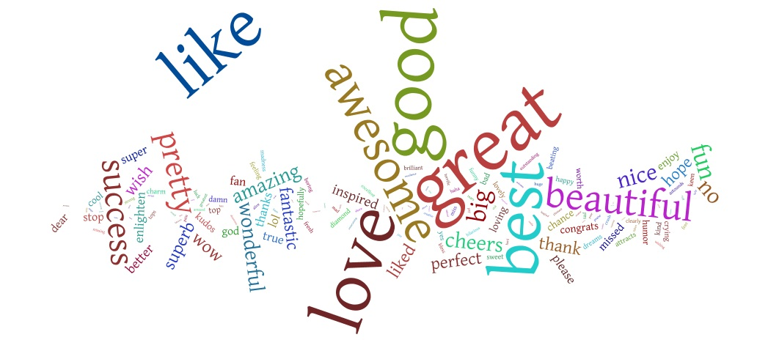

Sentiment Analysis
Notes:
Do we know the topic number for this?

Slide 4

INDEX
  What is sentiment analysis?
  Applications of sentiment analysis
  Sources of data
  Methodology
  Machine Learning Classification Methods
Notes:
A major chunk of this chapter “Sentiment Analysis “ will be on understanding the various machine learning techniques used for classifying the sentiments.
Under that we ll cover what is the intuition behind these classification techniques?
Naïve Bayes, Random Forest, SVM, Maximum Entropy
WE ll also cover how to implement this using R tool

Slide 5

INDEX
  What is sentiment analysis?
  Applications of sentiment analysis
  Sources of data
  Methodology
  Machine Learning Classification Methods
Notes:
A major chunk of this chapter “Sentiment Analysis “ will be on understanding the various machine learning techniques used for classifying the sentiments.
Under that we ll cover what is the intuition behind these classification techniques?
Naïve Bayes, Random Forest, SVM, Maximum Entropy
WE ll also cover how to implement this using R tool

Slide 6

What is sentiment analysis?
Classification of the polarity of a given text in the document, sentence, or feature level
Expressed opinion : positive/negative/neutral
Notes:
The problem in sentiment analysis is classifying the polarity of a given text at the document, sentence, or feature level
whether the expressed opinion in a document, a sentence or an entity feature is positive,negative, or neutral
IT is the process of basically identifying people s opinions and attitudes.

Slide 7
INDEX
  What is sentiment analysis?
  Applications of sentiment analysis
  Sources of data
  Methodology
  Machine Learning Classification Methods
Notes:
A major chunk of this chapter “Sentiment Analysis “ will be on understanding the various machine learning techniques used for classifying the sentiments.
Under that we ll cover what is the intuition behind these classification techniques?
Naïve Bayes, Random Forest, SVM, Maximum Entropy
WE ll also cover how to implement this using R tool

Slide 8
Applications
Advertising
Building recommendation Engines
Use
Source
Products in a store
Food in restaurants
Movies
Notes:
Let’s look at some examples where we can capture people’s sentiments :
You look at whether customers are happy with the products purchased or not.
The next example is about whether customers like the food and ambience in a restaurant.
Whether a customer likes a movie or not based on say genre, direction of the movie, the graphics used,etc.Could be n number of factors
All this information can be received by simply giving feedback forms to a customer. Right?
Now how is all this useful
Firstly , its very useful in advertising. For example, people who live in Bangalore often Like Taj mahal Tea whereas people who live in Hyderabad like “red label” more.
So based on this information, as an advertiser, I can maybe try to sell more of Taj mahal tea in Bangalore and completely stop advertising in Hyderabad, because clearly People of Hyderabad prefer only Red label.
Similarly, for restaurants, I can study how many people like my restaurant more? If they do not like it, what is the reason? Etc
Now you have many websites these days, for example, Zomato. IF you have not heard of it. What it does is that it studies your past likes and dislikes of all the restaurants you have visited, and then recommends a restaurant of your choice. So sentiments can be used to build recommendation engines also.

Slide 9
INDEX
  What is sentiment analysis?
  Applications of sentiment analysis
  Sources of data
  Methodology
  Machine Learning Classification Methods
Notes:
A major chunk of this chapter “Sentiment Analysis “ will be on understanding the various machine learning techniques used for classifying the sentiments.
Under that we ll cover what is the intuition behind these classification techniques?
Naïve Bayes, Random Forest, SVM, Maximum Entropy
WE ll also cover how to implement this using R tool

Slide 10
Sources of data
You can use any text data to analyse
Sources of Data
Twitter data
Facebook data
Product Reviews
Notes:
Closing Audio to be recorded
Under this topic we have discussed in detail about
…..
That’s it for this topic.
For any queries, do email us at info@jigsawacademy.com
Thanks!

Slide 11
Sources of data
In this class we will be using twitter data to do sentiment analysis
Notes:
Closing Audio to be recorded
Under this topic we have discussed in detail about
…..
That’s it for this topic.
For any queries, do email us at info@jigsawacademy.com
Thanks!

Slide 12
INDEX
  What is sentiment analysis?
  Applications of sentiment analysis
  Sources of data
  Methodology
  Machine Learning Classification Methods
Notes:
A major chunk of this chapter “Sentiment Analysis “ will be on understanding the various machine learning techniques used for classifying the sentiments.
Under that we ll cover what is the intuition behind these classification techniques?
Naïve Bayes, Random Forest, SVM, Maximum Entropy
WE ll also cover how to implement this using R tool

Slide 13
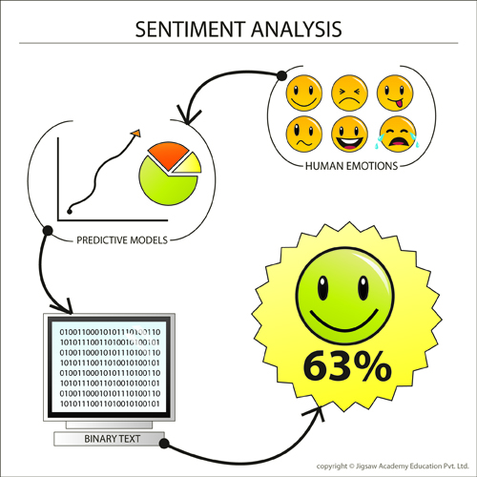
Methodology
Notes:
Intuition of sentiment analysis
1.First collect your text data and divide them into whether they are happy statements/sad statements/neutral ie, positive,negative,etc .This is your training data sample.
2.These sentiments are then fed into predictive models. These are nothing but your classification models .It will study patterns and predict which statements are positive, which are negative, etc
3.The model then converts the information to a binary form.ie 1 s and 0’s. These are nothing but your predicted outcomes. Wht your model thinks the sentiment should be based on the algorithm used.
4.Finally the model classifies the sentiments and predicts the % of sentiments.
But it is not quite straighfoward as it seems ! So let’s take a look at the methodology in detail.

Slide 14
Methodology
Tweets Retrieval
Data Pre-processing
Input Keyword
Classified Tweets
Classification Algorithm
Notes:
Let’s look the Flow chart for running a sentiment analysis. We will consider some text extracted from Twitter.
Steps :
1.Input the required keyword we want into twitter
2.Extract all the tweets from twitter.
For Example : The input word you give is “Modi”.
So all the tweets made about Modi in a given period of time will be extracted.
So what are you trying to do here? You are essentially capturing all the people’s sentiments about Modi.
3.Process the data :
The data extracted cannot be directly used.
We need to pre-process /clean the data.
Cleaning involves :
Making sure the text data is devoid of unnecessary information
Converting text data to numeric data – which is more meaningful. Why is that? This is cause your predictive models only understand numeric data and not just plain text.
4.Once we have the tweets, assign sentiments to the required tweets.
For example : “Modi is a genius” is a tweet. You need to assign a classifier “Positive” for this tweet. Similarly you will need to do that for all the tweets.
Once you do that, This will be the training dataset.
5.Then use a classification algorithm to learn which word belongs to which sentiment ie build a model on the training dataset.
6.Once the model is built, we can then test the algorithm on the validation dataset, and this algorithm should be able to classify which sentiment a new tweet will belong to.

Slide 15
INDEX
  What is sentiment analysis?
  Applications of sentiment analysis
  Sources of data
  Methodology
  Machine Learning Classification Methods
Notes:
A major chunk of this chapter “Sentiment Analysis “ will be on understanding the various machine learning techniques used for classifying the sentiments.
Under that we ll cover what is the intuition behind these classification techniques?
Naïve Bayes, Random Forest, SVM, Maximum Entropy
WE ll also cover how to implement this using R tool

Slide 16
Machine learning Classification Methods
  Naïve Bayes
  Random Forest
  SVM
  Maximum Entropy
Notes:
We know that the Polarity of a given text is either positive, negative or neutral. Classifying text according to polarity is a difficult task.These are some of the most common and effective machine learning classification algorithms used :
Naïve Bayes
Random Forest
SVM
Maximum Entropy
Let’s look at some of these algorithms in the following sessions
Maximum Entropy
The principle of Maximum entropy is an axiom used in Bayesian Probability theory. Here the observed data is taken as the input and is tested. This is made use in natural language processing.

Slide 17
Machine learning Classification Methods
  Naïve Bayes
  Random Forest
  SVM
  Maximum Entropy
Notes:
We know that the Polarity of a given text is either positive, negative or neutral. Classifying text according to polarity is a difficult task.These are some of the most common and effective machine learning classification algorithms used :
Naïve Bayes
Random Forest
SVM
Maximum Entropy
Let’s look at some of these algorithms in the following sessions
Maximum Entropy
The principle of Maximum entropy is an axiom used in Bayesian Probability theory. Here the observed data is taken as the input and is tested. This is made use in natural language processing.

Slide 18
Why Naïve Bayes?
The classification method used here is based on Bayes Rule
Depends on “Bag of words” representation of a document

Slide 19
The bag of words representation
This is a fabulous hotel! From the moment they collect you from the airport to getting to your room, the service is impeccable. All the staff were so attentive and accommodated all our needs. Very close to the International airport and 20 minutes to domestic. Took time to walk in the lawn. Feels great. Walk around the lounge. Nice place to window shop. Would highly recommended staying at this hotel again.
Notes:
Imagine I have a document which is a review about the hotel. We are trying to understand what do people feel about this hotel?
Our job is to create a function that takes in this document and return a class. Ie positive or negative ?
So which is it?
In order to solve this task, we will look at individual words in this document.All the other words have disappeared.
So the bag of words representation is nothing but all important words.
We then take the counts of each of these words in the document.
For example ,
Great occurred twice, etc.

Slide 20
The bag of words representation
This is a fabulous hotel! From the moment they collect you from the airport to getting to your room, the service is impeccable. All the staff were so attentive and accommodated all our needs. Very close to the International airport and 20 minutes to domestic. Took time to walk in the lawn. Feels great. Walk around the lounge. Nice place to window shop. Would highly recommended staying at this hotel again.
Notes:
So which is it?
In order to solve this task, we will look at individual words in this document.All the other words have disappeared.

Slide 21
The bag of words representation
Subset of words
Xxxxxx fabulous xxxxxxxxxxxxxxxxxxxxxxxx
xxxxxxxxxxxxxxxxxxxxxxxx xxxxxx xxxxxxxxxx x, xxxxxxxxxxx impeccable xxxxxxxxxxxxxxxxxxxx
attentive xx accommodated xxxxxxxxxxxxxxx. xxxxxxxxxxxxxxxxxxxxxxxxxxxxxxxxxxxxxxxxxxxxxxxxxxxxxxxxxxxxxxxxxxxxxxxxxxxxxxxxxxxxxxxxxx xxx great. xxxxxxxxxxxxxxxxxx Nice xxxxx xxxxxxxxxxxxxx xxxxxx recommended xxxx xxxxxxxxxxxxxx great xxxx
Notes:
So the bag of words representation is nothing but all important words.
We then take the counts of each of these words in the document.
For example ,
Great occurred twice, etc.

Slide 22
The bag of words representation
fabulous | 1
impeccable | 1
attentive | 1
accommodated | 1
great | 2
nice | 1
  So ‘Bag of words’ means text represented as collection of it’s words, discarding grammar and order of words but keeping multiplicity
Notes:
This is the frequency distribution of the words occurring in the text or tweets.

Slide 23
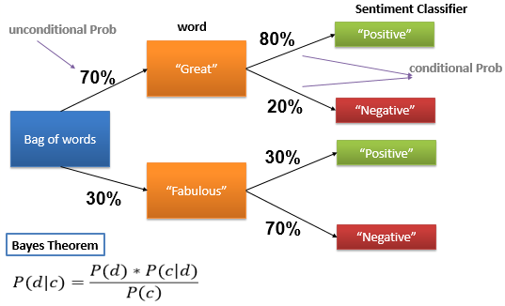
According to Bayes Theorem
Notes:
In a given set of reviews, you have all kinds of words occurring. Let’s take a specific case and examine, the % positives and % negatives tagged.
Here :
Whenever the word “great” appears, 80% of the statements are positive and 20% of the statements are negative
Similarly whenever the word “Fabulous” appears, 30% of the statements are positive and 70% of them are negative.
This is maybe because, with fabulous, there are many other negative words present. Hence the overall sentiment happens to be mostly negative.
Let’s get some definitions straight first.
Unconditional Probability:
Probability of the word occurring .
P(“great”)=70%
IF you notice:
70% is an uncondional prob of the word “great” occurring from a bag of words. It doesn’t depend on anything.
On the other hand, as we discussed 80% you see here is conditional prob.It is the prob of the class given the word.
80% = p(class/word)
Conditional Probability: P(class/word) :
The 80% you see is the conditional Probability: I.e. the (% of positives) given the word “great”. So it is conditional on the word “great”.
Joint Probability: P(word*class)
The probability of the word “great” occurring and the probability of it being classified as “positive “ or “negative”
=70% * 80%
P(word*class)=P(word) P(class/word)
=P(“great”) P(“Positive”/”great”)
=70% * 80% = 56%
P(word*class)=P(word) P(class/word)
=P(“great”) P(“negative”/”great”)
=70% * 20% = 14%

Slide 24
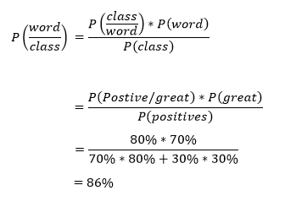
According to Bayes Theorem
Notes:
What is this Bayes Formula?
We know the following :
1.Conditional Prob : P(class/word)
2.Unconditional Prob : P(word)
3.Joint Prob
Using this we find out : P(word/class) .
What if I observe,(ie knowing that) the word is positive, then what is the chance that it is the word “great”?
This is what bayes theorm helps you find out
Ie P(word/class)
P(word/class) = P(class/word) *P(word) / P(class)
= P (positive/great) *P(great) / P(positives)
= 80% * 70*/ ( 70% * 80% +30% * 30% )
= 86 %

Slide 25

According to Bayes Theorem
For document d and class c
d : document = consists of words
c : classifier = sentiments(positive or negative)
P(d) : probability of document(containing words)
P(c/d) :
conditional probability
Probability of the class(positive or negative) given the word
P(c) :
Unconditional probability
Probability of the class I,e. P(positive ) ,P(negative)
Notes:
So as we discussed here, the bayes formula is as follows :

Slide 26


According to Bayes Theorem
But we are interested in the term , P(c/d)
Notes:
P(c/d) = Prob(class/ word)
So given a document, we want to try and find out which class it belongs to .
By Bayes rule, the formula is as mentioned.

Slide 27
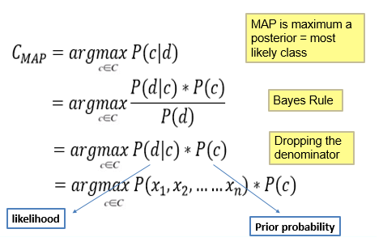
According to Bayes Theorem
Notes:
What are we doing here ?
1.Finally what classification does the document get ?
The best class , the class we are looking for to assign the document to is out of all classes , the one that maximizes the prob (class/document)
2.By bayes rule, plug in the equation
3.Dropped the denominator. Why is it ok ?
P(d) = how likely the document is . Suppose for 10 words , we compute the Prob(word) which in this case maybe say 1/10th. Then in that case the P(d) will
Always remain a constant, hence we can drop the denominator.
4.Now we are trying to find a class that maximizes the product of :
P(word/class) and P(class)
5.What is this P(d|c) ?
Eg , given class, what is the prob of movie reviews?
We are hence splitting it to features x1,x2,….
How to compute :
P(Class) :that’s just asking do positive reviews occur more frequently than negative reviews? Basically the unconditional prob
Intuition :
For every document, we find
P(positive/words)
P(negative/words)
Which ever prob is higher, the classifier assigns that class to that word .

Slide 28


Naïve Bayes Assumptions
Bag of words assumption : position doesn’t matter
Conditional Independence :Assume the feature probabilities P(x|c) are independent given to the class c
Notes:
Assumptions :
1.The first assumption Here position of the word in the document doesn’t matter….first or 100th…all we care about is the features.
2.The second assumption is The different features ie words x1,x2, their prob are independent given a class.
Remember, these are just assumptions.They are not necc correct. But makes things easier for us.
By using these assumptions, we devise a formula for joint prob
Joint P(x1…xn given a class) = product of indv prob (this is the independent prob formula)

Slide 29
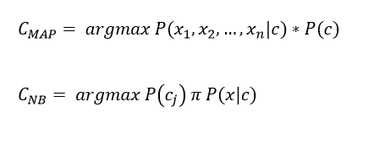
Naïve Bayes Classifier
Notes:
Let’s rewrite this equation
In order to compute simplifying naïve bayes assumption ,
The best class by naïve bayes assumption is :
The one that maximizes
We multiply the whole prob f features with our prior prob.WE can rewirte this equation

Slide 30
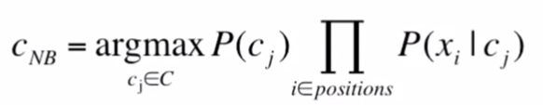
Naïve Bayes Classifier
Here positions = all word positions in the test document
Notes:
We calculate two things :
For each class, (eg positive) ie the j values :
1.Whats the prob of that class? Eg : say P(positives)
2.For each position , the word in that position, whats the prob(word given that class) For eg: P(great/positive) P(fabulous/positive)
All this is taken from the set of words and their corresponding tags in the given document.
Do this for each class. Whichever has the maximum prob , assign that class to that sentence or document.
So that’s the formulization for Naïve bayes classifier.

Slide 31
Machine learning Classification Methods
  Naïve Bayes
  Random Forest
  SVM
  Maximum Entropy
Notes:
We know that the Polarity of a given text is either positive, negative or neutral. Classifying text according to polarity is a difficult task.These are some of the most common and effective machine learning classification algorithms used :
Naïve Bayes
Random Forest
SVM
Maximum Entropy
Let’s look at some of these algorithms in the following sessions
Maximum Entropy
The principle of Maximum entropy is an axiom used in Bayesian Probability theory. Here the observed data is taken as the input and is tested. This is made use in natural language processing.

Slide 32
Random Forest Index
What is a decision Tree?
Decision Tree classification Example
What is a random Forest?
Random Forest Algorithm
OOB Error
Strengths and Weaknesses
Decision Tree Text Classification
Random Forest Classification
Random Forest Implementation in R
Notes:
We know that the Polarity of a given text is either positive, negative or neutral. Classifying text according to polarity is a difficult task.These are some of the most common and effective machine learning classification algorithms used :
Naïve Bayes
Random Forest
SVM
Maximum Entropy
Let’s look at some of these algorithms in the following sessions
Maximum Entropy
The principle of Maximum entropy is an axiom used in Bayesian Probability theory. Here the observed data is taken as the input and is tested. This is made use in natural language processing.

Slide 33
What is a Decision Tree?
It is a:
Greedy
top-down
Binary recursive partitioning
Divides feature space into sets of disjoint rectangular regions.
Notes:
Decision tree is :
It is a greedy, top-down binary, recursive partitioning, that divides feature space into sets of disjoint rectangular regions.

Slide 34
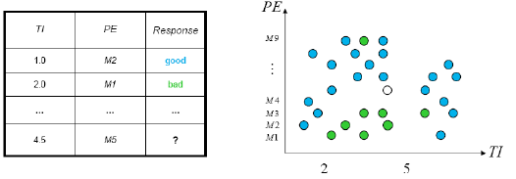
Decision Tree Classification Example
Simple dataset with two predictors
Notes:
Let’s look at this example data :
Each row represents a data point. Each column represents an attribute.
We have 2 features ie A and B . A is a numeric attribute, B is a categorical variable. Reponse is the column that gives a “Class” to each row.
Now running a plot between A and B, we see some of the points are “good”(blue in color) and some are “bad”(red in color). But how do we find out, given a point, will it be good or bad?
For that we make use of decision trees

Slide 35
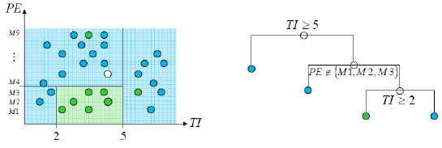
Decision Tree Classification Example
Greedy, recursive partitioning along TI and PE
Notes:
Let’s look at the rules that partition this data along A and B.
So let’s split the data into a tree like structure :
The left side of the split is a “TRUE” on the condition . The right side is a “FALSE” on the condition.
So how to read this tree :
So first split is : A>=5, if that is not true, and then B present in G1,G2,G3 and A>=2
So if you check this rule in the graph: WE see we have corned all the Red points.
This is what decision trees helps us with. Build rules to identify and separate the “Response” variables

Slide 36
What is a random Forest?
Ensemble Learning Technique
“Forest” of decision Tree classifiers
Each Tree is capable of giving some influence as to what features are important to distinguishing the label
Finally aggregate the results of the trees
Notes:
Random forest is nothing but collection of decision trees.
We build many trees and then combine the results to give us the final classification.
That is why it is called an “ensemble” of different trees

Slide 37
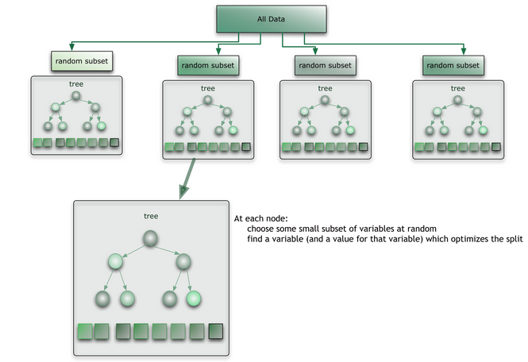
Random Forest Algorithm
Notes:
The exact process works like this :
1)You choose random samples of the data. .This process is called “Bootstrapping”.In each subset,build a tree based on different features
2)From each tree extract which class the row belongs to.
3)Look at the classifications from different trees for each row in your dataset. Which ever class occurs maximum no of times, ie the majority “class” by all trees is then assigned as the winner class. This process is called Bagging
1.Bootstraping is the process of choosing random samples from the given dataset. Each sample is used to build a tree.
2.Bagging is then done ie take the mode of the classifier of N trees to get the desired output

Slide 38
Random Forest Algorithm
For b = 1 to B :
  Draw a bootstrap Sample of size N from the training data
  Grow a random Forest Tree Tb to the bootstrapped data ,by recursively repeating the following steps for each terminal node of the tree, until the maximum node size is reached
    Select m predictor variables at random from all the p predictor variables
    Pick the best variable/split-point amongst the m
    Split the node into two daughter nodes
Output the ensemble of trees
Notes:
From the book of Hiestie Freeman
Lieu bryman proposed the strategy :
Let each classifier have a different subset of the data .So pull out different subsets/samples with replacement.
You then start growing a tree on each of these subsets .
The tree is grown based on :
Choosing few Predictor variables ie m out of the p variables
And grow the tree until the best split of the leaf node is reached
Finally combine the out put of all the random forest trees .
If you notice, every tree will have different samples on which it has build the tree and also different features/predictor variables used for building the tree.
So the major advantage here is that, even if we missed some pattern on trend in one tree, it is captured by another tree.This is one of the major advantages of random fores

Slide 39
OOB Error
Each observation is an OOB observation for some of the trees, i.e. it was not used to construct them and can thus be considered as an internal validation dataset for these trees.
The OOB error of the RF is simply the average error frequency obtained when the observations from the data set are predicted using the trees for which they are OOB.
Notes:
What is OOB? OOB Stands for out of bag.The observations which are not in the sample are considered as out of the bag samples. IT simply means they are not part of the training or sample dataset.Hence these can be used for validation purposes.
The error obtained by testing the random forest algorithm on this out of bag or validation sample is called OOB error

Slide 40
Strengths and Weaknesses
Strengths:
Selects only important features
Can handle noisy or missing data very well
Can be used with extremely large number of features or samples
Weakness :
Unlike Decision Trees, the model is not easily interpretable
Sometimes it overfits the data

Slide 41
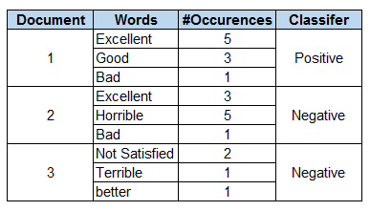
Decision Tree : Text Classification
Predict the class each document belongs to:
Notes:
1.This is the training dataset which contains for every document , the #times each word occurs and the classifier it belongs to.
2.The classifier in this case is the sentiment : Positive or negative
3.Using this data, we need to predict the sentiment for any new document

Slide 42
Decision Tree : Text Classification
Excellent>=3
Yes
No
Excellent>3
Positive = 50%
Negative =50%
Positive = 50%
Negative =50%
Horrible>=5
Yes
Good>=3
Yes
No
Positive = 100%
Negative =0%
Positive=0%
Negative =100%
Positive = 0%
Negative =100%
Notes:
By showing you this tree :
I am giving you an intuition of how the tree might be built for sentiment analysis :
For every combination of words occurring in the document, the tree does a best split
For Example : IF the word “excellent” occurs in the document ,only 50% of the times the document is classified as positive
However, if excellent occurs in the document with good >=3 , then 100% of the times it is tagged as a positive comment
This is an example of a basic decision tree algorithm for sentiment analysis.

Slide 43
Random Forest : Classification
Training Data
Feature Set1
Feature Set2
Feature Set3
Feature Set4
Sample1
Sample2
Sample3
Sample4
Decision Tree1
Decision Tree2
Decision Tree3
Decision Tree4
Positive
Positive
Negative
Positive
Decides Positive!
Notes:
Say we take random samples of the data.
Here feature set will be different combination of words occurring n the document.
Now we build random trees on each of these samples.
DT1 classifies this document as positive,DT2 classifies this document as positive, DT3 classifies as negative and so forth.
Finally since majority of the trees decided positive, the document is given the classification “Positive”.

Slide 44
Random Forest in R
Building the classifier :
M<-randomForest (train,class,ntree=500,mtry=sqrt(p))
train : training data
class: the classification column in the data
mtree : Number of trees to grow
mtry (optional) : The number of features to randomly select at each split (uses sqrt(p) by default where p is the number of features in the dataset)
Package used : randomForest

Slide 45
Random Forest in R
Making Predictions:
p<-predict(m,test,type=“response”)
m: It is the model object
test: It is a dataset containing the same features as the training dataset used to build the classifier
mtree : Number of trees to grow
type: It contains “response”,”prob”, or “votes” and is used to indicate whether the predictions vector should contain predicted class,predicted prob or a matrix of vote counts

Slide 46
Machine learning Classification Methods
  Naïve Bayes
  Random Forest
  SVM
  Maximum Entropy
Notes:
We know that the Polarity of a given text is either positive, negative or neutral. Classifying text according to polarity is a difficult task.These are some of the most common and effective machine learning classification algorithms used :
Naïve Bayes
Random Forest
SVM
Maximum Entropy
Let’s look at some of these algorithms in the following sessions
Maximum Entropy
The principle of Maximum entropy is an axiom used in Bayesian Probability theory. Here the observed data is taken as the input and is tested. This is made use in natural language processing.

Slide 47
SVM Index
Intuition behind SVM
Implementation in R
Notes:
We know that the Polarity of a given text is either positive, negative or neutral. Classifying text according to polarity is a difficult task.These are some of the most common and effective machine learning classification algorithms used :
Naïve Bayes
Random Forest
SVM
Maximum Entropy
Let’s look at some of these algorithms in the following sessions
Maximum Entropy
The principle of Maximum entropy is an axiom used in Bayesian Probability theory. Here the observed data is taken as the input and is tested. This is made use in natural language processing.

Slide 48
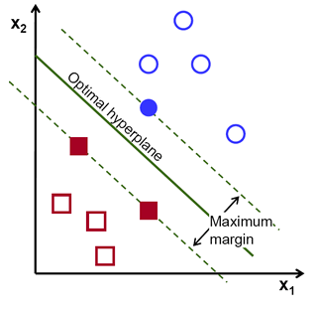
Intuition behind SVM
SVM : Support Vector Machine
Notes:
SVM is a classification technique that is listed under supervised learning models in Machine Learning.
In layman's terms, it involves finding the hyper plane/decision plane that best separates two classes of points with the maximum margin.
A decision plane is one that separates between a set of objects having different class memberships
What is a hyperplane? : (line in 2D, plane in 3D and hyper plane in higher dimensions. More formally, a hyperplane is n-1 dimensional subspace of an n-dimensional space)
Large distance between the decision boundary and the samples, makes the probability of missclassifying lower.
The data points that kind of "support" this hyperplane on either sides are called the "support vectors“.
In the above picture, the filled blue circle and the two filled squares are the support vectors. For cases where the two classes of data are not linearly separable, the points are projected to an exploded (higher dimensional) space where linear separation may be possible.

Slide 49
Model Performance Metrics
The model performance metrics are same for any classification problem
True positives (TP) - Correctly identified as success
True negatives (TN) - Correctly identified as failure
False positives (FP) - success incorrectly identified as failure
False negatives (FN) - failure incorrectly identified as success
Precision - P = TP/(TP+FP) how many identified actually success/failure
Recall - R = TP/(TP+FN) how many of the successes correctly identified
F-score - F = (2 * P * R)/(P + R) harm mean of precision and recall
Notes:
What is a confusion Matrix?

Slide 50
Implementation in R
Implementation in R
Naïve Bayes
Random Forest
SVM
Maximum Entropy
Notes:
What is a confusion Matrix?

Slide 51

RECAP
…..
Notes:
Closing Audio to be recorded
Under this topic we have discussed in detail about
…..
That’s it for this topic.
For any queries, do email us at info@jigsawacademy.com
Thanks!

Slide 52
THANK YOU

